Slide 1
Workplace Fatalities: A Comparison of Canadian Jurisdictions with a Focus on Saskatchewan September 29, 2016
Sean Tucker (sean.tucker@uregina.ca)
Faculty of Business Administration
University of Regina

Slide 2
Acknowledgements and Note on Sources
Thank you to J.D. Bell, Gabrielle Klass, Noah Li, and Eagleclaw Thom for their assistance with this research.
Copies of these slides and supporting AWCBC data are available at: http://www.uregina.ca/business/faculty-staff/faculty/tucker-sean.html

Slide 3
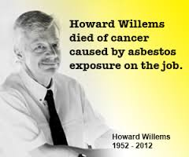
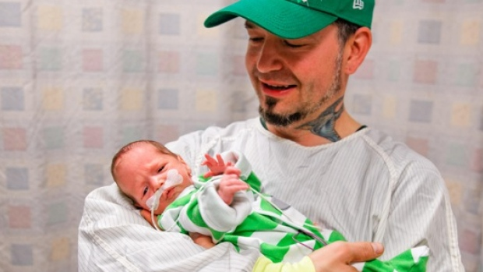
Some of the Workers Who Have Died on the Job in Saskatchewan Since 2009

Slide 4
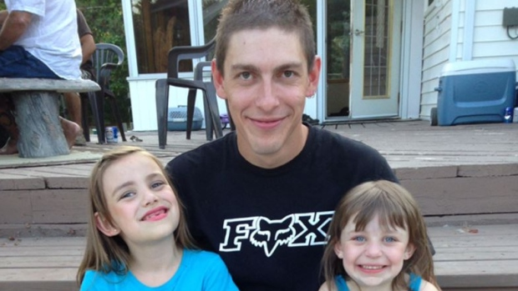
Several Fatalities During the Summer of 2016

Slide 5
Agenda
Background on work-related injury and fatality data
Work-related lost-time injury rate, 2000 to 2014
Work-related fatality rate, 2002 to 2014
Factors associated with work-related fatalities in Saskatchewan
Preventing work-related fatalities in Saskatchewan

Slide 6
Work-Related Injury and Fatality Data in Canada

Slide 7
Work-Related Injury and Fatality Data in Canada

Slide 8
Work-Related Lost-Time Injuries

Slide 9
Lost-Time Injury Rate (per 100 FTEs) Calculation
Work-related lost-time injury
Definition varies by jurisdiction
AWCBC definition:
"A lost-time claim is a claim where an employee is compensated for a loss of wages following a work-related injury (or exposure to noxious substance), or receives compensation for a permanent disability with or without any time lost in his or her employment."
Total # LT Injuries
Total # of Full Time Equivalents
(FTE)
Lost-time injury rate =
X 100

Slide 10
FTEs and Total Employed in a Jurisdiction
The percentage of workers with WCB coverage varies by jurisdiction.
About 48,000 employers in Saskatchewan are insured by the Saskatchewan WCB. Employers in some sectors are self-insured (e.g., agriculture, school teachers)
The total number of FTE reflects the estimated number of employees covered by a WCB, NOT the total number of people employed in a jurisdiction.
In 2014, 73% of workers (or about 403,000 workers) in Saskatchewan were covered by the Saskatchewan WCB.
The coverage rate in Alberta and Manitoba is 92% and 76%, respectively.

Slide 11
Average Work-Related Lost-Time Injury Rate 2000 to 2014 (per 100 FTE)
Saskatchewan has the second highest average work-related lost-time injury rate.
15% lower than Manitoba’s rate.
75% higher than Alberta’s rate.

Slide 12
Work-Related Lost-Time Injury Rate in SK, AB, and MB (2000 to 2014)

Slide 13
Work-Related Lost-Time Injury Rate
In 2015 Saskatchewan’s lost-time injury rate was 2.07 per 100 FTE

Slide 14
Work-Related Fatalities

Slide 15
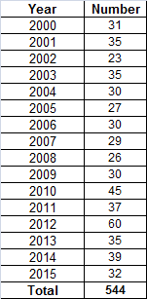
Number of Work-Related Fatalities in Saskatchewan Since 2000

Slide 16
Fatality Rate (Per 100,000 FTE) Calculation
Work-related fatality
Definition varies by jurisdiction
AWCBC definition:
" A fatality is a death resulting from a work-related incident (including disease) that has been accepted for compensation by a Board/Commission."
Two categories: Injury and occupational disease
Total # Fatalities
Total # of Full Time Equivalents
(FTE)
Fatality rate =
X 100,000

Slide 17
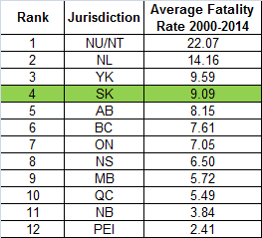
Average Work-Related Fatality Rate 2000 to 2014 (per 100,000 FTE)
Saskatchewan has the fourth highest average work-related fatality rate.
59% higher than Manitoba’s rate.
12% higher than Alberta’s rate.

Slide 18
Average Work-Related Fatality Rate AB, MB, SK (2000-2009)
SK Average Fatality Rate 2000-2009 = 8.3 per 100,000

Slide 19
Average Work-Related Fatality Rate AB, MB, SK (2000-2014)
SK Average Fatality Rate 2010-2014 = 10.7 per 100,000

Slide 20
Work-Related Injury Fatalities

Slide 21
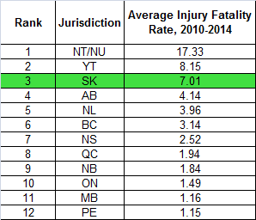
Average Injury Fatality Rate 2010-2014 (per 100,000)
Saskatchewan has the third highest average injury-related fatality rate.
504% higher than Manitoba’s rate.
69% higher than Alberta’s rate.

Slide 22
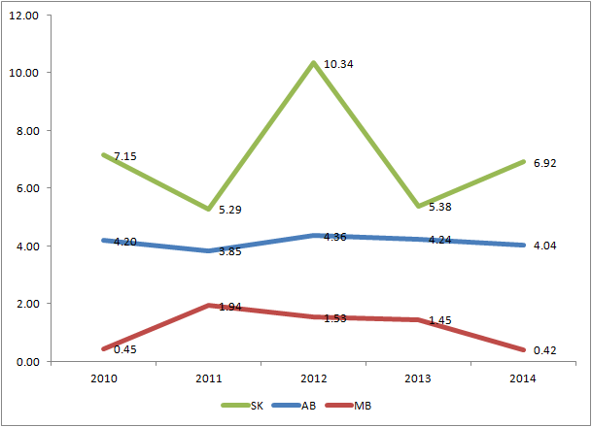
Work-Related Injury Fatality Rate in AB, MB, SK 2010-2014

Slide 23
Work-Related Injury Fatality Rate
In 2015 Saskatchewan’s injury-related fatality rate was 5.49 per 100,000.

Slide 24
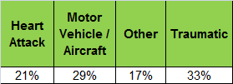
Work-Related Injury Fatalities in Saskatchewan by Cause (2011-2015, 137 Fatalities)
Source: Saskatchewan WCB

Slide 25
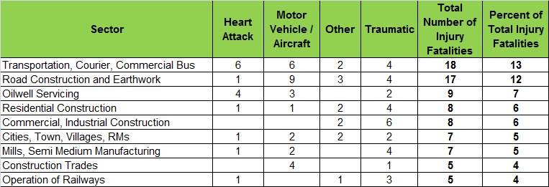
Work-Related Injury Fatalities in Saskatchewan by Cause and Sector (2011-2015, 137 Fatalities)
Source: Saskatchewan WCB

Slide 26
Work-Related Occupational Disease Fatalities

Slide 27
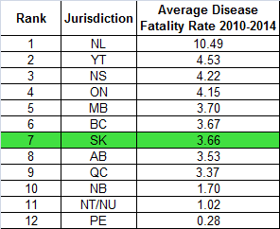
Average Occupational Disease Fatality Rate 2010-2014 (per 100,000)
Saskatchewan has the sixth lowest average occupational disease fatality rate.
1% lower than Manitoba’s rate.
4% higher than Alberta’s rate.

Slide 28
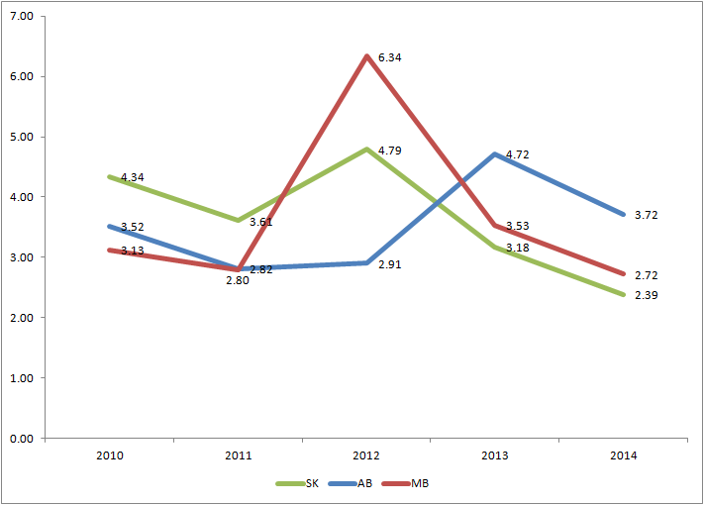
Occupational Disease Fatality Rate in AB, MB, SK 2010-2014

Slide 29
Disease-Related Fatality Rate
In 2015 Saskatchewan’s disease-related fatality rate was 2.15 per 100,000.

Slide 30
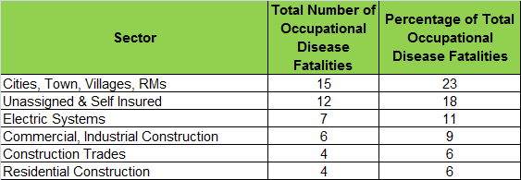
Work-Related Occupational Disease Fatalities in Saskatchewan by Sector (2011-2015, 66 Fatalities)
Source: Saskatchewan WCB

Slide 31
Observations and Recommendations

Slide 32
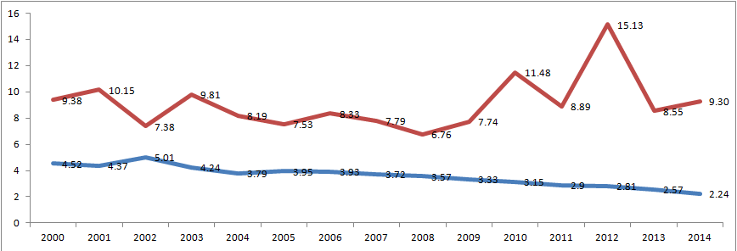
A Puzzle: Saskatchewan’s Steadily Declining Time-Lost Injury Rate and Recent Increase in Injury-Related Fatality Rate
SK Fatality Rate per 100,000
SK Injury Rate per 100

Slide 33
Actions being Taken to Prevent Serious Injuries and Fatalities in Saskatchewan
Detailed information on fatalities being studied to identify patterns
Serious injury and fatality prevention strategy being developed
Campaign and resources to encourage safer driving
2,500 workplace inspections in 2015 (75% "targeted" and 25% random)
Inspection blitzes of high risk sectors
Saskatchewan Employment Act provides for penalties up to $1.5 million
Evidence gathering training for OHO inspectors
Several injury prevention activities are being undertaken to strengthen Saskatchewan's safety culture.

Slide 34
Enhancing Prevention of Serious Injuries and Fatalities
1. Targeted safety inspections in Saskatchewan are effective but compliance in some sectors remains low.
Hire and train a minimum of 10 additional Occupational Health Officers to work in the field.

Slide 35
Enhancing Prevention of Serious Injuries and Fatalities
2. Summary Offense Ticketing (SOT) was introduced in 2014 and yet few OHO's are able to issue tickets.
Increase the number of OHOs with the credentials to issue SOTs. Apply SOTs to a wider range of contraventions.

Slide 36
Enhancing Prevention of Serious Injuries and Fatalities
3. Increase public awareness by publicly disclosing, in a timely manner, limited information about individual work-related fatalities.
See, for example, Ontario Ministry of Labour (https://www.labour.gov.on.ca/english/hs/fatalities.php)

Slide 37
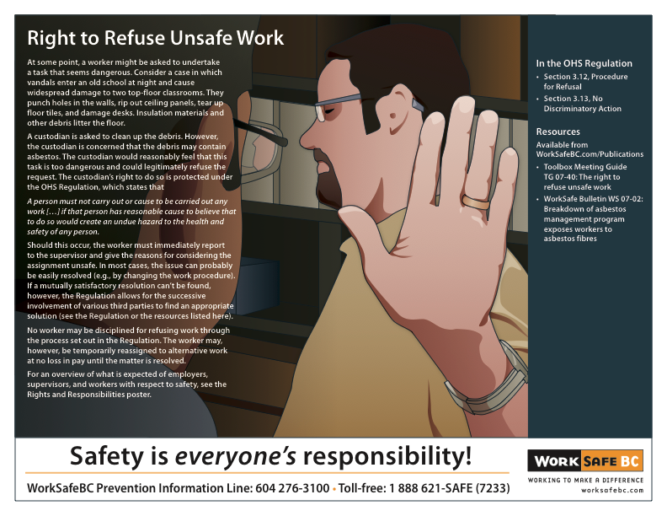
Enhancing Prevention of Serious Injuries and Fatalities
4. Increase public awareness about how to refuse potentially dangerous work.
Targeted education for employers and employees about the refusal process and protection from retaliation.

Slide 38
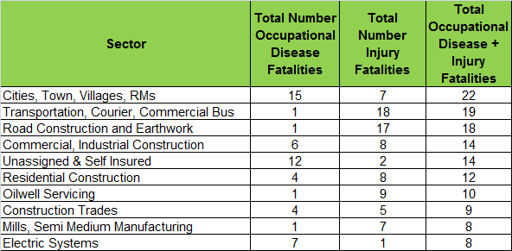
Work-Related Fatalities in Saskatchewan by Type and Sector (2011-2015, 203 Fatalities)
Source: Saskatchewan WCB

